Slide 1
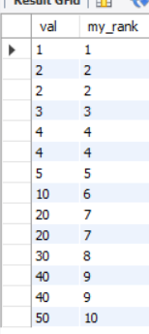
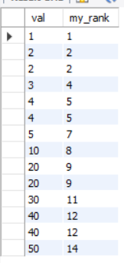
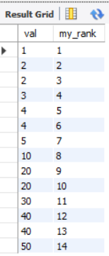
CREATE TABLE t (
val INT
);
INSERT INTO t(val) VALUES(1),(2),(2),(3),(4),(4),(5);
INSERT INTO t(val)VALUES(10),(20),(20),(30),(40),(40),(50);
SELECT val, DENSE_RANK() OVER ( ORDER BY val ) my_rank FROM t;
SELECT val, RANK() OVER ( ORDER BY val ) my_rank from t;
SELECT val, row_number() over( ORDER BY val ) my_rank FROM t;

Slide 2
The RANK() function in MySQL is a window function that assigns a rank to each row based on a specified ordering. It’s especially useful when you want to reflect ties in your data—like ranking students by scores or employees by sales.
How RANK() Works
- Rows with equal values (ties) get the same rank.
- The next rank is skipped based on the number of tied rows.
ROW_NUMBER()
- Assigns a unique sequential number to each row.
- No ties: even if values are the same, each row gets a different number.
- ✅ Use when you want a strict ordering with no duplicates.

Slide 3
Internal Mechanics of RANK() in MySQL
The RANK() function is part of MySQL’s window functions, introduced in version 8.0. It assigns a rank to each row within a partition of the result set, based on the ORDER BY clause. Here's how it operates internally:
1. Partitioning the Data
- If you use PARTITION BY, MySQL first divides the result set into logical partitions.
Each partition is processed independently.
2. Sorting Within Each Partition
- MySQL sorts the rows in each partition according to the ORDER BY clause.
This sorting is crucial because rank is based on the order of values.
3. Assigning Ranks
- MySQL iterates through the sorted rows.
- It compares the current row’s value(s) with the previous row:
- If the value is the same → same rank.
- If different → rank = previous rank + number of tied rows.
- This is why RANK() can produce gaps in ranking when there are ties.
4. Tracking State
Internally, MySQL maintains:
- A counter for the current rank.
- A peer group size to handle ties.
- A buffer to store intermediate results during sorting and ranking.

Slide 4
🔍 Example
SELECT
employee,
sales,
RANK() OVER (ORDER BY sales DESC) AS rank
FROM sales_data;
If two employees have the same sales, they’ll get the same rank, and the next rank will skip accordingly.
⚙️ Performance Notes
- MySQL uses temporary tables and sort buffers to handle window functions.
- Efficient indexing on ORDER BY columns can improve performance.
- For large datasets, window functions can be memory-intensive, so query optimization matters.

Slide 5
DENSE_RANK function
The DENSE_RANK() is a window function that assigns a rank to each row within a partition or result set with no gaps in ranking values.
The rank of a row is increased by one from the number of distinct rank values which come before the row.
The syntax of the DENSE_RANK() function is as follows:
DENSE_RANK() OVER (
PARTITION BY <expression>[{,<expression>...}]
ORDER BY <expression> [ASC|DESC], [{,<expression>...}]
)
In this syntax:
First, the PARTITION BY clause divides the result sets produced by the FROM clause into partitions. The DENSE_RANK() function is applied to each partition.
Second, the ORDER BY clause specifies the order of rows in each partition on which the DENSE_RANK() function operates.
If a partition has two or more rows with the same rank value, each of these rows will be assigned the same rank.

Slide 6
the OVER() clause is used with window functions to define how rows are grouped and ordered for calculations—without collapsing them like traditional aggregate functions do.
What is a Clause?
A clause is a component of a SQL statement that defines specific behavior or conditions. It’s like a building block that shapes how the query works.
Examples:
- WHERE clause → filters rows
- ORDER BY clause → sorts results
- GROUP BY clause → groups rows for aggregation
- OVER() clause → defines a window for window functions
Clauses don’t return values on their own—they modify how a statement behaves.
window_function(...) OVER (
[PARTITION BY column]
[ORDER BY column]
[ROWS BETWEEN ...])

Slide 7
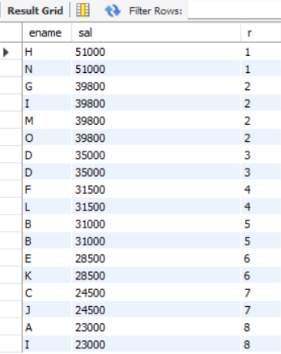

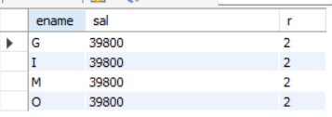
CREATE TABLE emp (
ename varchar(255),
sal INT
);
SELECT ename, sal, DENSE_RANK() OVER (ORDER BY sal DESC) r FROM emp
INSERT INTO emp (ename, sal) VALUES('A', 23000),('B', 31000),('C', 24500),('D', 35000),('E', 28500),('F', 31500),('G', 39800),('H', 51000),('I', 39800);
SELECT ename, sal, DENSE_RANK() OVER (ORDER BY sal DESC) r FROM emp limit 0,2
select * from(select ename, sal, dense_rank() over(order by sal desc)r from emp) AS ranked_employees where r=2;
Better because it display name and sal both
This is name of virtual table

Slide 8
Why It’s Called a Virtual Table
- It doesn’t exist physically in the database.
- It’s created temporarily during query execution.
- You can treat it like a regular table in the outer query (e.g., filter with WHERE, join with other tables, etc.).
If you want to reuse this logic across multiple queries, you could also turn it into a view, which is a stored virtual table.
Creating a View
CREATE VIEW ranked_employees AS
SELECT ename, sal, DENSE_RANK() OVER (ORDER BY sal DESC) AS r
FROM emp;
Now, instead of nesting it every time, you can simply query:
SELECT * FROM ranked_employees WHERE r = 2;
Benefits
- Cleaner queries
- Reusable logic
- Easier debugging and reporting

Slide 9


select distinct sal from emp order by sal desc limit 1,1
select distinct sal, ename from emp order by sal desc limit 1,1

Slide 10
CREATE TABLE sales(
sales_employee VARCHAR(50) NOT NULL,
fiscal_year INT NOT NULL,
sale DECIMAL(14,2) NOT NULL,
PRIMARY KEY(sales_employee, fiscal_year)
);
INSERT INTO sales(sales_employee,fiscal_year,sale)
VALUES('Bob',2016,100),
('Bob',2017,150),
('Bob',2018,200),
('Alice',2016,150),
('Alice',2017,100),
('Alice',2018,200),
('John',2016,200),
('John',2017,150),
('John',2018,250);
SELECT * FROM sales;

Slide 11
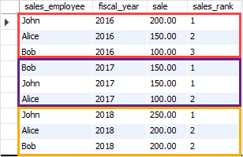
The following statement uses the DENSE_RANK() function to rank the sales employees by sale amount.
SELECT
sales_employee, fiscal_year, sale,
DENSE_RANK() OVER (PARTITION BY
fiscal_year
ORDER BY
sale DESC
) sales_rank
FROM
sales;
In this example:
First, the PARTITION BY clause divided the result sets into partitions using fiscal year.
Second, the ORDER BY clause specified the order of the sales employees by sales in descending order.
Third, the DENSE_RANK() function is applied to each partition with the rows order specified by the ORDER BY clause.

Slide 12
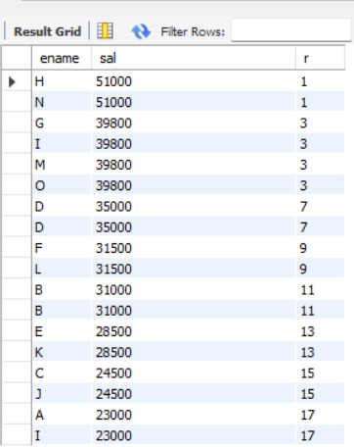
select ename, sal, rank() over(order by sal desc)r from emp;
Use Cases for RANK() in MySQL
1. Leaderboards with Ties
Want to rank players, employees, or students where multiple people might share the same score?

